Slide 1
StorScore system for SSD qualification
Dr. Laura Caulfield
Mark Santaniello

Slide 2
Outline
Introduction
Who we are
Unique needs & opportunities
Motivation
Background
SSD testing “gotchas”
How it works
Recipes: define the test suite
Scores: compare devices and summarize performance
Endurance: measurement of write amplification
Demo

Slide 3
Introduction

Slide 4
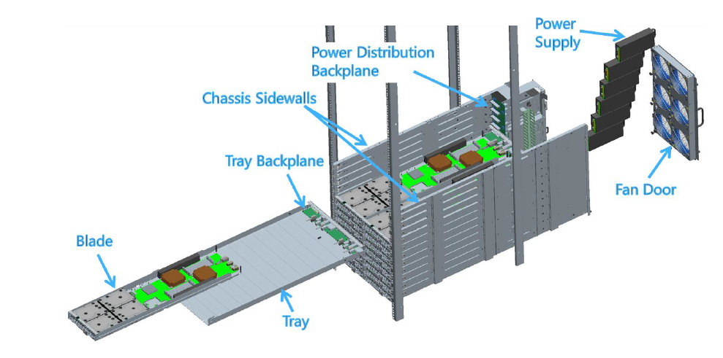
Who we are
Cloud server infrastructure engineering
Designers of Open Cloud Server
Part of the Open Compute Project
http://opencompute.org

Slide 5
Unique needs & opportunities
Microsoft’s platform
Variety / quantity of workloads
Flexibility to modify stack
Co-design SSD & apps
Wide variety of expertise
Additional metrics
System development (Web search, hosted cloud, etc.)
SSD vendors

Slide 6
Motivation
Need for a component-level storage test (AVL/QCL)
Problems with 3rd-party testing services
Want test results under Windows, not Linux
Need results in our server, not a “reference platform”
Desire to share results with component vendors
Existing tools are insufficient (Iometer, etc.)
GUI = difficult to automate properly, therefore error-prone
Microsoft-specific tests (SMART injection)
Cloud metrics (QoS via 5-nines percentile latency)
Methodology is critical when testing SSDs

Slide 7
Background

Slide 8
SSD gotcha – initial performance
NAND must be erased before it can be programmed
When fresh-out-of-box, all NAND is already erased
Drive contains more NAND than the user-visible space
Overprovisioned (OP) space, typically 7% or 28%
This is an unnatural and ephemeral state
Reads short-circuit if block state is erased (never go to media)
Sustained writes will eventually require garbage collection (GC)
StorScore initializes by writing the entire SSD 2x
Every user-exposed LBA is written twice
Virtually guaranteed to cover any OP space

Slide 9
SSD gotcha – history effect
Workload A
Workload B
Steady-state
Transition
Steady-state
Previous workload affects current workload
Transition phase can take hours
Main causes
FTL map fragmentation (ex: random → sequential)
Concurrent garbage collection activity (ex: 100% write → 0% write)

Slide 10
SSD gotcha – history effect, continued
Consistent workload will eventually reach steady-state
1st Pass, 3.5 hours
30 – 100 MB/sec
2nd Pass, 30 minutes
~220 MB/sec
1st Pass
2nd Pass

Slide 11
SSD gotcha – detecting steady-state
StorScore includes precondition.exe
Always drives to steady-state before measuring performance
Method: rolling linear regression, detect near-zero slope
StorScore performs all sequential tests before any random tests
Minimizes fragmentation and therefore time required to achieve steady-state

Slide 12
SSD gotcha – entropy of written data
Some controllers can compress on-the-fly
Customer data is often compressible
Entropy has a big impact on performance and endurance
StorScore supports variable compressibility
Uses incompressible data by default
Allows use of compressible data in 10% increments

Slide 13
How it works

Slide 14
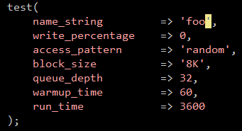
Recipes – a single test
The entire contents of single.rcp
Reference the file from the cmd line: C:\>StorScore --recipe=single.rcp
Reads like English

Slide 15
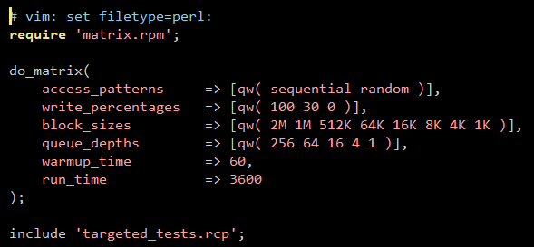
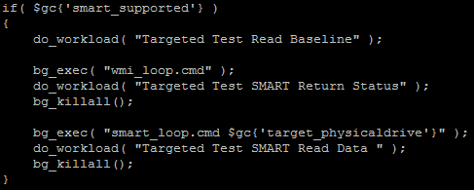
Recipes – a matrix of tests
Mimics test designer’s whiteboard sketch
Include statements combine test files
Full functionality of Perl

Slide 16

Results parser
Raw output files → one Excel file
Detects, highlights outliers
Easy pivot tables & graphs
Still too much data
5,232 files x 23 metrics = 120k data points
24 SSDs
x 218 workloads
5,232 files
Display Name | Write Mix | Access Size (kB) | Access Type | Queue Depth | Bandwidth (MB/s) | Average Latency (ms)
Device A | 100% | 16 | random | 1 | 54.32 | 1.04
Device B | 100% | 16 | random | 1 | 15.05 | 0.29
Device A | 30% | 16 | random | 1 | 20.01 | 1.39
Example policy:
Bandwidth matters a lot, latency matters a little
Device A scores 72/100
Device B scores 65/100

Slide 17
Putting the “score” in StorScore
Goal
Enable data-driven decisions throughout the company
Reduce data to 1 score / drive
Method
A weighted average of all the metrics for each workload
Step 1: Convert each value to z-score
Bandwidth (MB/s) | Average Latency (ms)
Z_AX0 | Z_AX1
Z_BX0 | Z_BX1
Z_AY0 | Z_AY1
Display Name | Write Mix | Access Size (kB) | Access Type | Queue Depth | Bandwidth (MB/s) | Average Latency (ms)
Device A | 100% | 16 | random | 1 | 54.32 | 1.04
Device B | 100% | 16 | random | 1 | 15.05 | 0.29
Device A | 30% | 16 | random | 1 | 20.01 | 1.39

Slide 18
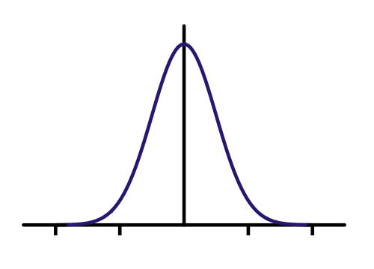
Calculating z-scores
A z-score (or standard score) is the number of standard deviations from the mean
Drive: A
Workload: X (4k, rand, QD1, 100% writes)
Metric: 0 (Read Latency)
One z-score per data point
Positive = better than average
Negative = worse than average
Based on cohort of drives
z_{AX0}
Drive A
Bad
Distribution of
all drives
workload X
metric 0
Good

Slide 19
Applying scoring policies
General Policy:
Throughput Metrics
Latency Metrics
50%
z_{A(n+m)i}
+
50%
z_{A(n+m)j}
=
70 / 100
x
x
Drive A
Wkld range 0 to (n+m)
Metric range 0 to i
Score for Drive A
Can apply multiple policies at once
Can use any kind of weight system (stay consistent within policy)
Policy to Favor Mixed Workloads:
70/30 Read/Write Mix Workloads
100% Read & 100% Write Workloads
5 x
z_{An(i+j)}
+
1 x
z_{Am(i+j)}
=
65 / 100

Slide 20
Scores
If you’ve been using L, A-I will be comparable or better
A is best-in-class
E & N are stragglers
H is so close, and they’ve got a great price. How do we tweak the drive or application to make it work?

Slide 21
Scores’ breakdown
H is so close, and they’ve got a great price. How do we tweak the drive or application to make it work?
Answer: Drive should improve random mix (not seq. mix), or
App should favor sequential mix (not random mix)
Notes:
Quick Answer
Then: “This is a super useful chart – I’ve personally spent hours staring at these. 95% of the time is exploring new questions, not in looking for the answers”

Slide 22
SSD failure mechanism: writes
Drive Writes Per Day (DWPD)
Total Bytes Writes (TBW)
Drive Writes (DW)
Program / Erase Cycles (P/E Cycles, or PEC)
Write / Erase Cycles (W/E Cycles)
SSD
Controller
Controller Writes
NAND
Host Writes
NAND
NAND
NAND
Total Drive Writes
Write Amplification Factor Workload Dependent, Vendor Reported, Implementation Specific
x
=
P/E Cycles
Previously Available
SMART “Media Wear Indicator”
Reported in units of 1% (300 TB for 30k, 1TB drive)
4.7 months for 1 workload
New Telemetry
SMART “Controller Writes”
Reported in units of sectors or GB
1,700 workloads in 4.7 months
Notes:
Slowest workload: 64k random read/write mix, QD 1 (768 MB/s to the flash)

Slide 23
Endurance Results
Reported Range
Queue Depth
Write Size (kB)
Access Pattern

Slide 24
Endurance Results
Not all sequential workloads achieve High Endurance
Reported Range
Identify problem workloads
Queue Depth
Write Size (kB)
Access Pattern

Slide 25
Demo

Slide 26
Thanks!
Download StorScore
http://aka.ms/storscore
Questions?

Slide 27

© 2013 Microsoft Corporation. All rights reserved. Microsoft, Windows, Windows Vista and other product names are or may be registered trademarks and/or trademarks in the U.S. and/or other countries.
The information herein is for informational purposes only and represents the current view of Microsoft Corporation as of the date of this presentation. Because Microsoft must respond to changing market conditions, it should not be interpreted to be a commitment on the part of Microsoft, and Microsoft cannot guarantee the accuracy of any information provided after the date of this presentation. MICROSOFT MAKES NO WARRANTIES, EXPRESS, IMPLIED OR STATUTORY, AS TO THE INFORMATION IN THIS PRESENTATION.

